Slide 1
Radwan Mohamed Amin Hefny
MarketPricePrediction

Slide 2
Agenda
Introduction
Data Loading and Preprocessing
Data Transformation
Exploratory Data Analysis (EDA)
Feature Engineering
Model Selection
Model Training
Model Evaluation
Fine-tuning and Validation

Slide 3

Data Loading and Preprocessing

Slide 4
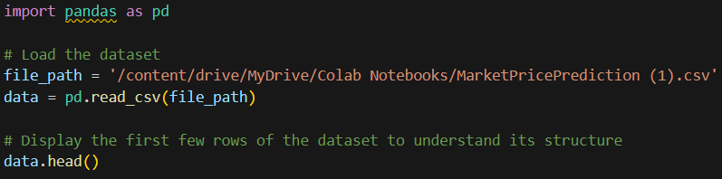
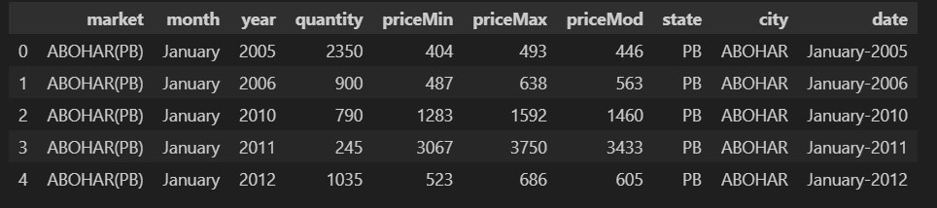
Load the Datasets
and Display Initial Data

Slide 5
Data Transformation

Slide 6
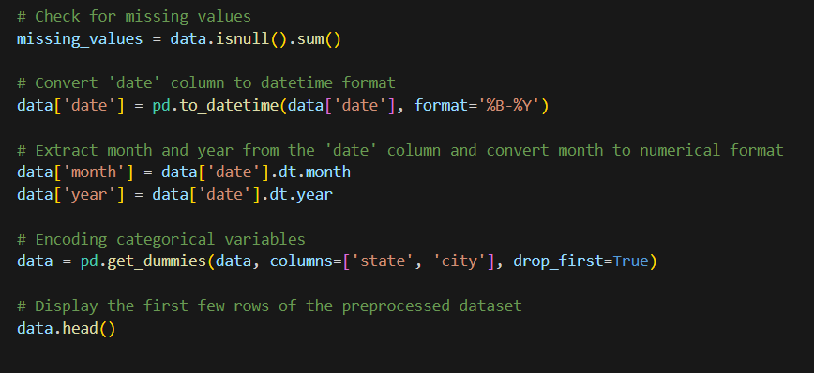
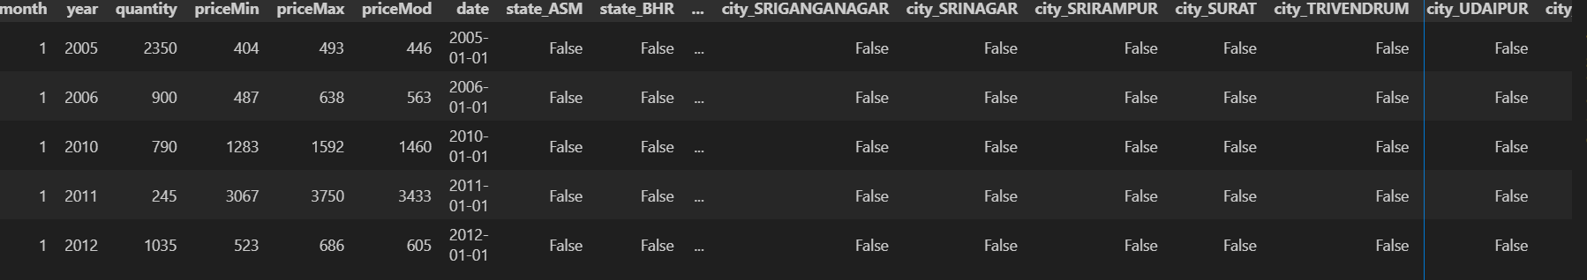
Convert
Date to date time format
Convert month and year to numerical
Encode state and city

Slide 7
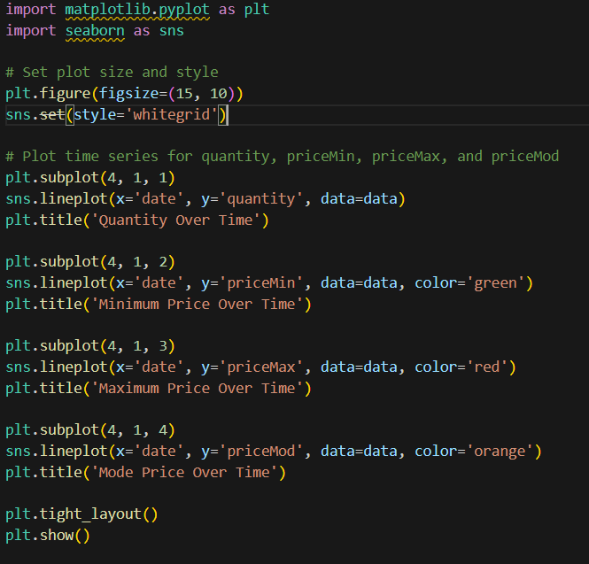
Exploratory Data Analysis (EDA)
Plot time series for quantity, priceMin, priceMax, and priceMod

Slide 8
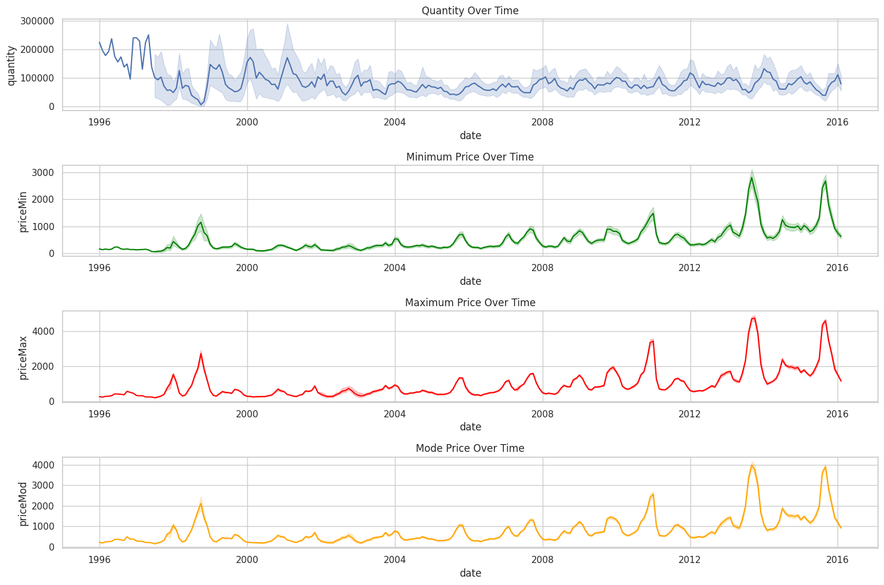

Slide 9
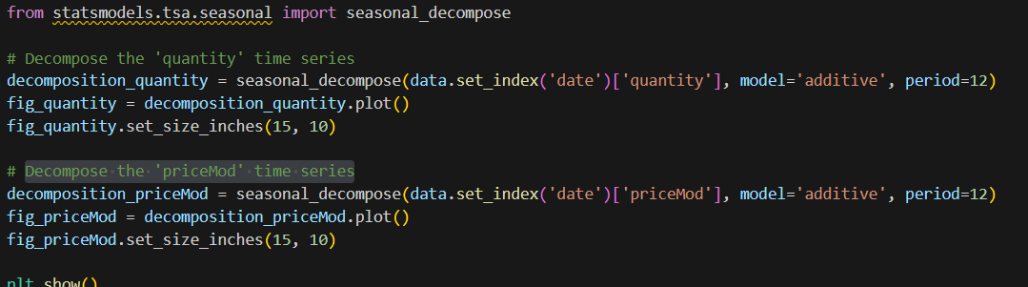
Data Analysis
Decompose the 'quantity' time series Decompose the 'priceMod' time series

Slide 10
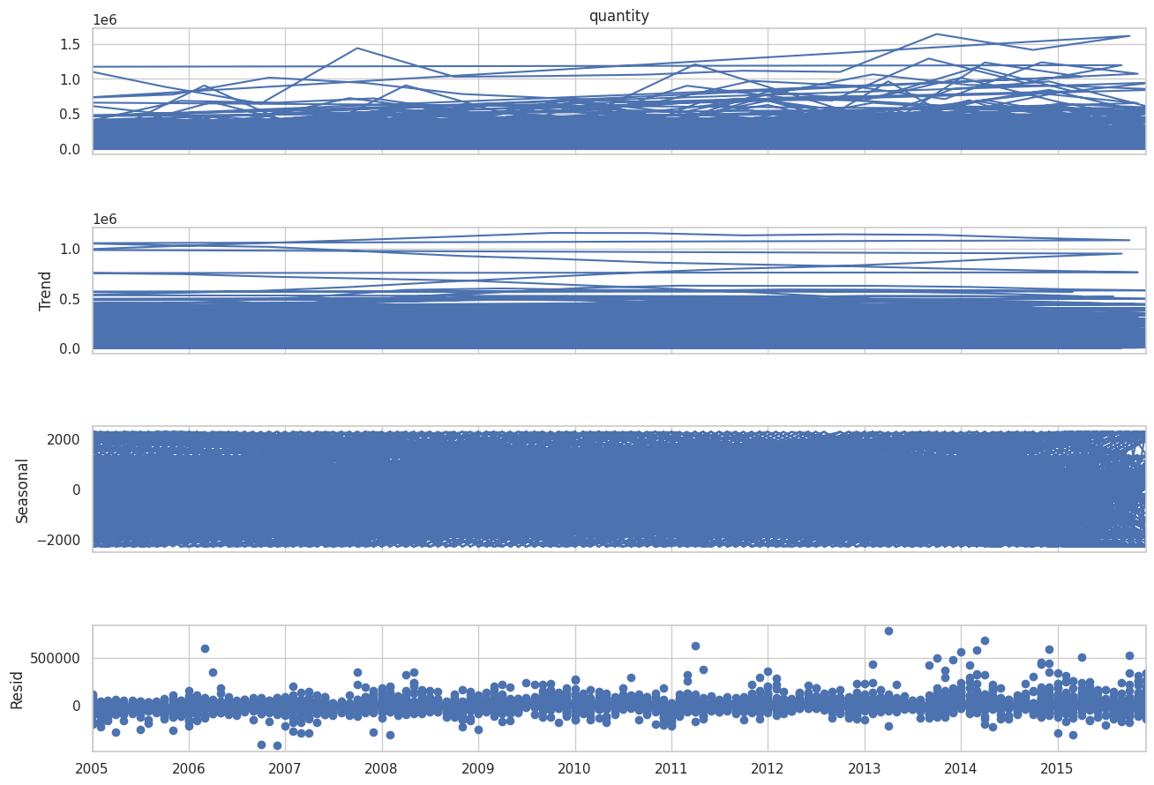

Slide 11
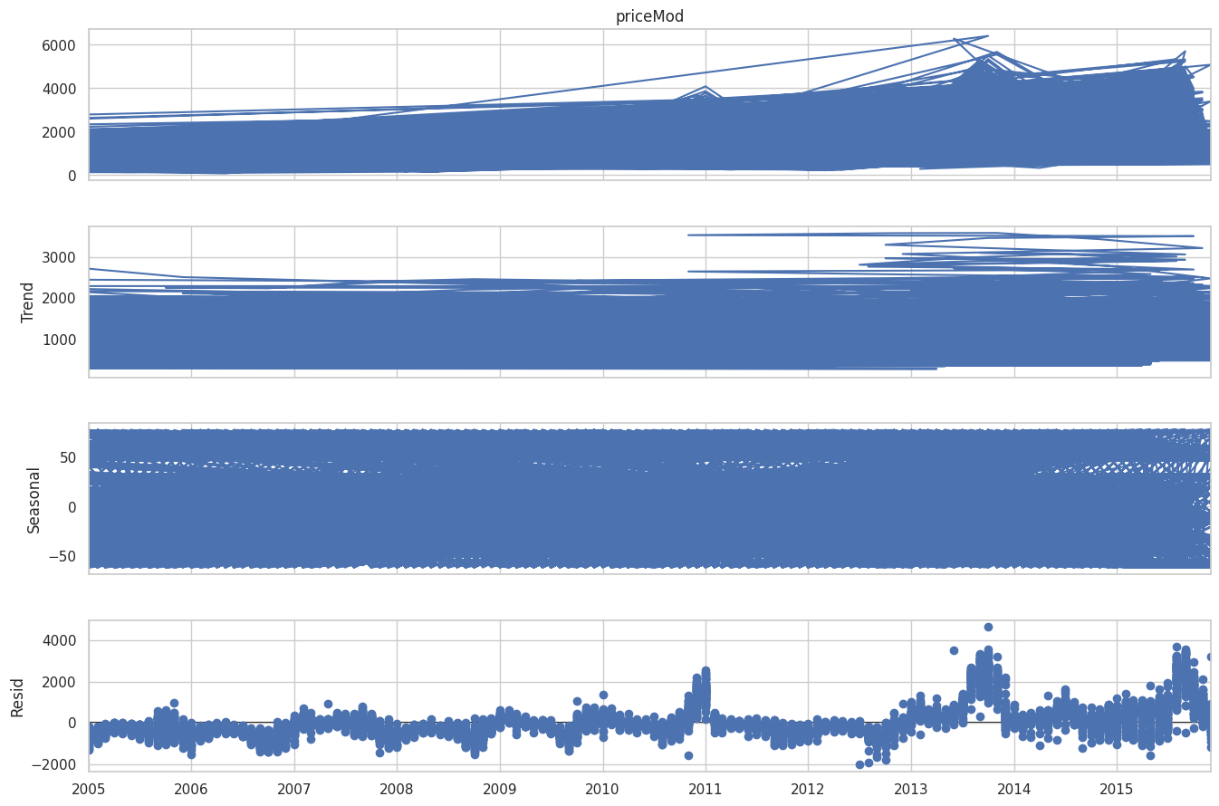

Slide 12
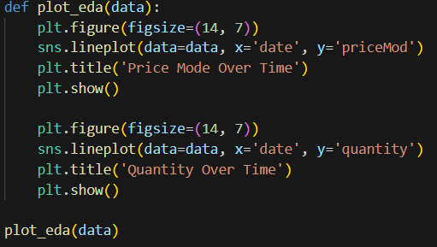
Data Analysis
Different plotting Plot time series for quantity, and priceMod

Slide 13
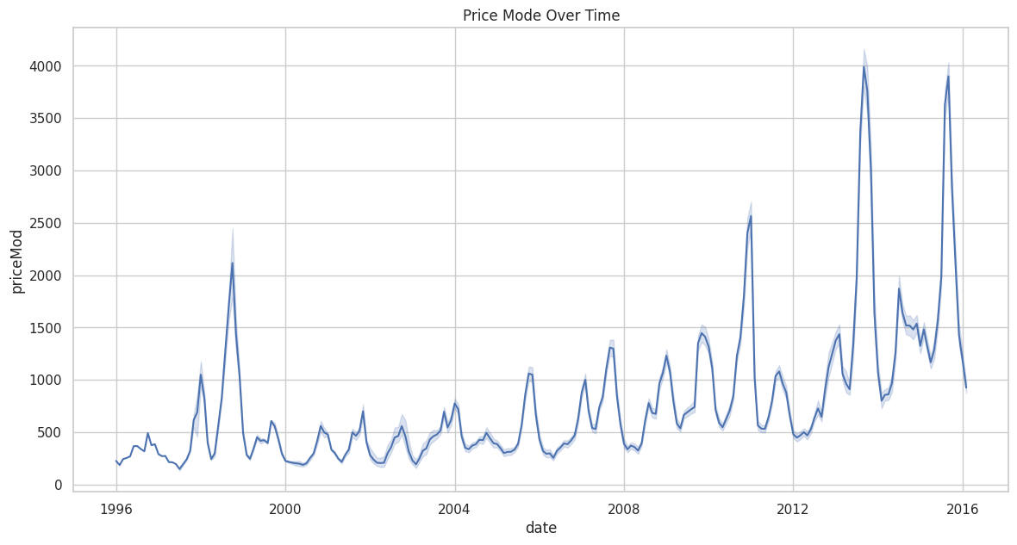
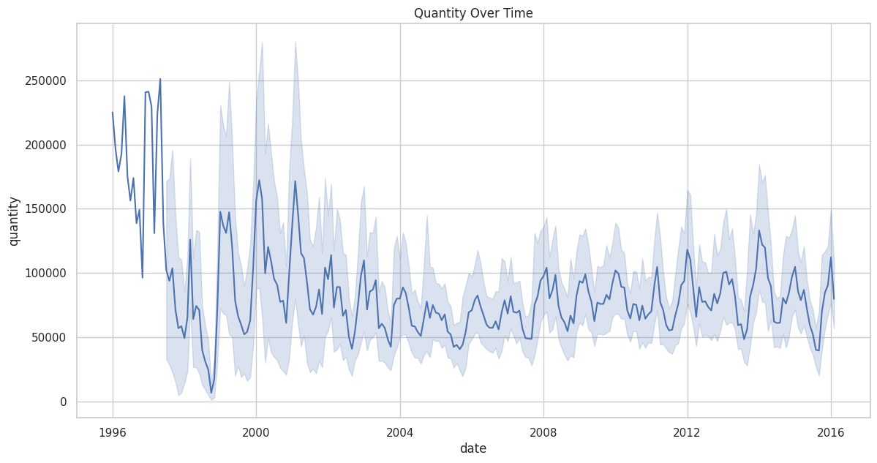

Slide 14
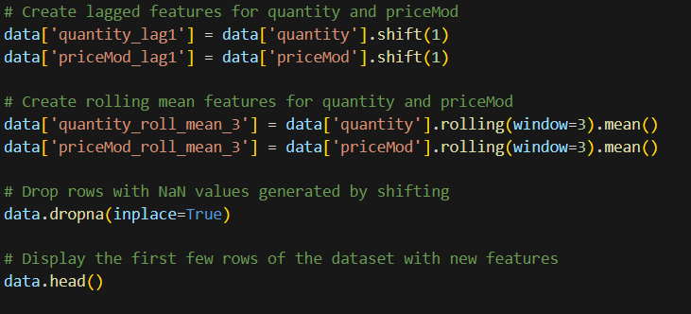
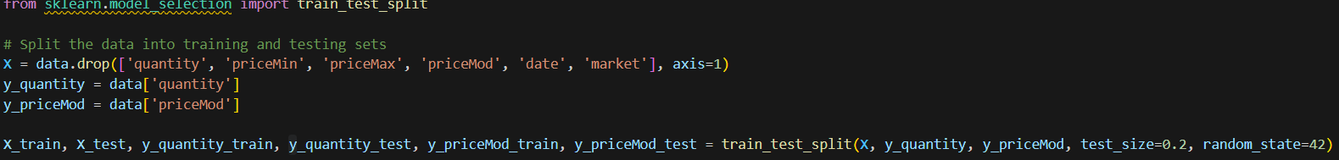
Feature Engineering
Create lagged features for quantity and priceMod
Create rolling mean features for quantity and priceMod
Split the data into training and testing sets

Slide 15

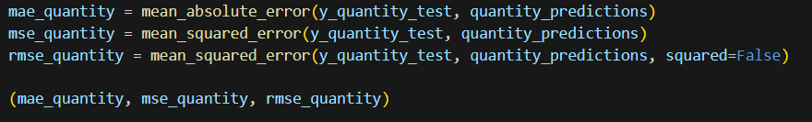
Model Training
Train ARIMA model for quantity prediction
Make predictions
Evaluate the model

Slide 16
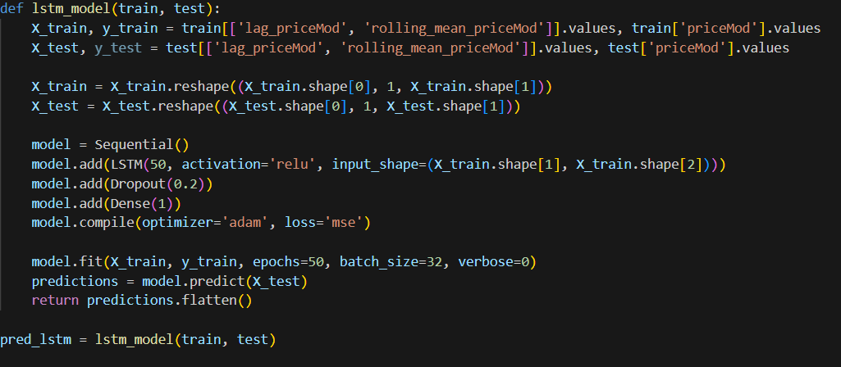
Model Training
Lstm Model

Slide 17
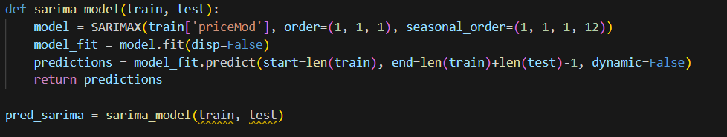
Model Training
Sarima Model

Slide 18
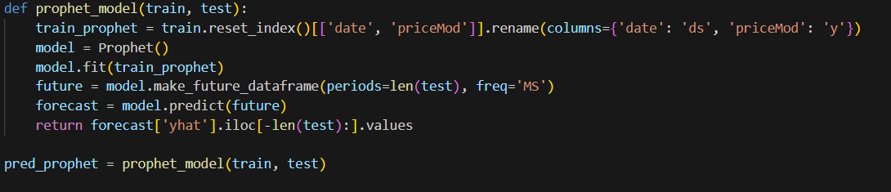
Model Training
Prophet model

Slide 19
Model Training
Prophet model

Slide 20
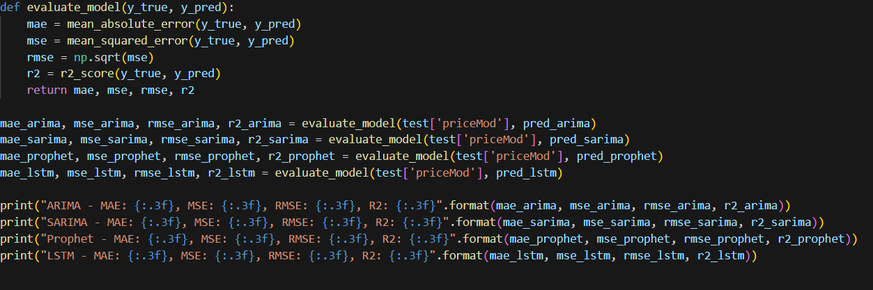
Model Evaluation
ARIMA - MAE: 542.175, MSE: 791888.667, RMSE: 889.881, R2: -0.331 SARIMA - MAE: 508.615, MSE: 618537.731, RMSE: 786.472, R2: -0.040 Prophet - MAE: 2458.230, MSE: 7246279.204, RMSE: 2691.891, R2: -11.180 LSTM - MAE: 300.714, MSE: 208748.982, RMSE: 456.891, R2: 0.649

Slide 21
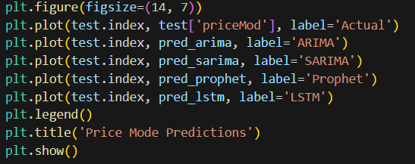
Model Evaluation
Plot predictions

Slide 22
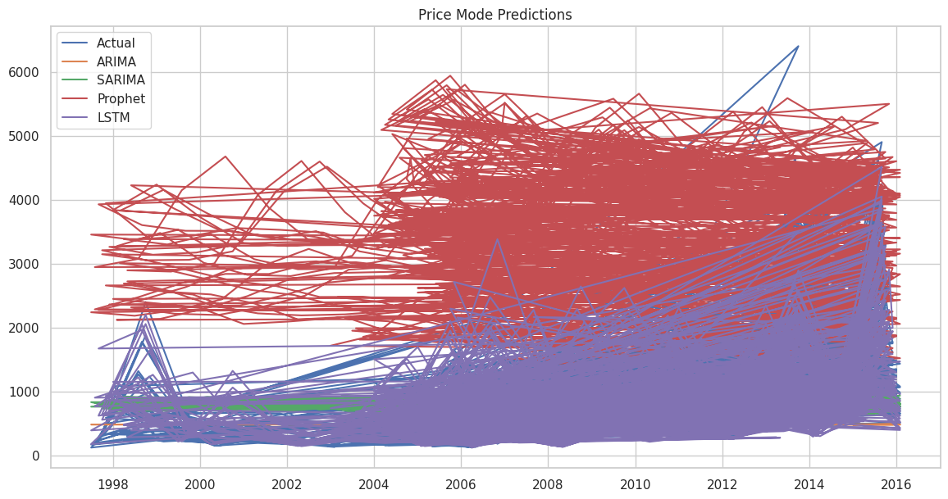

Slide 23
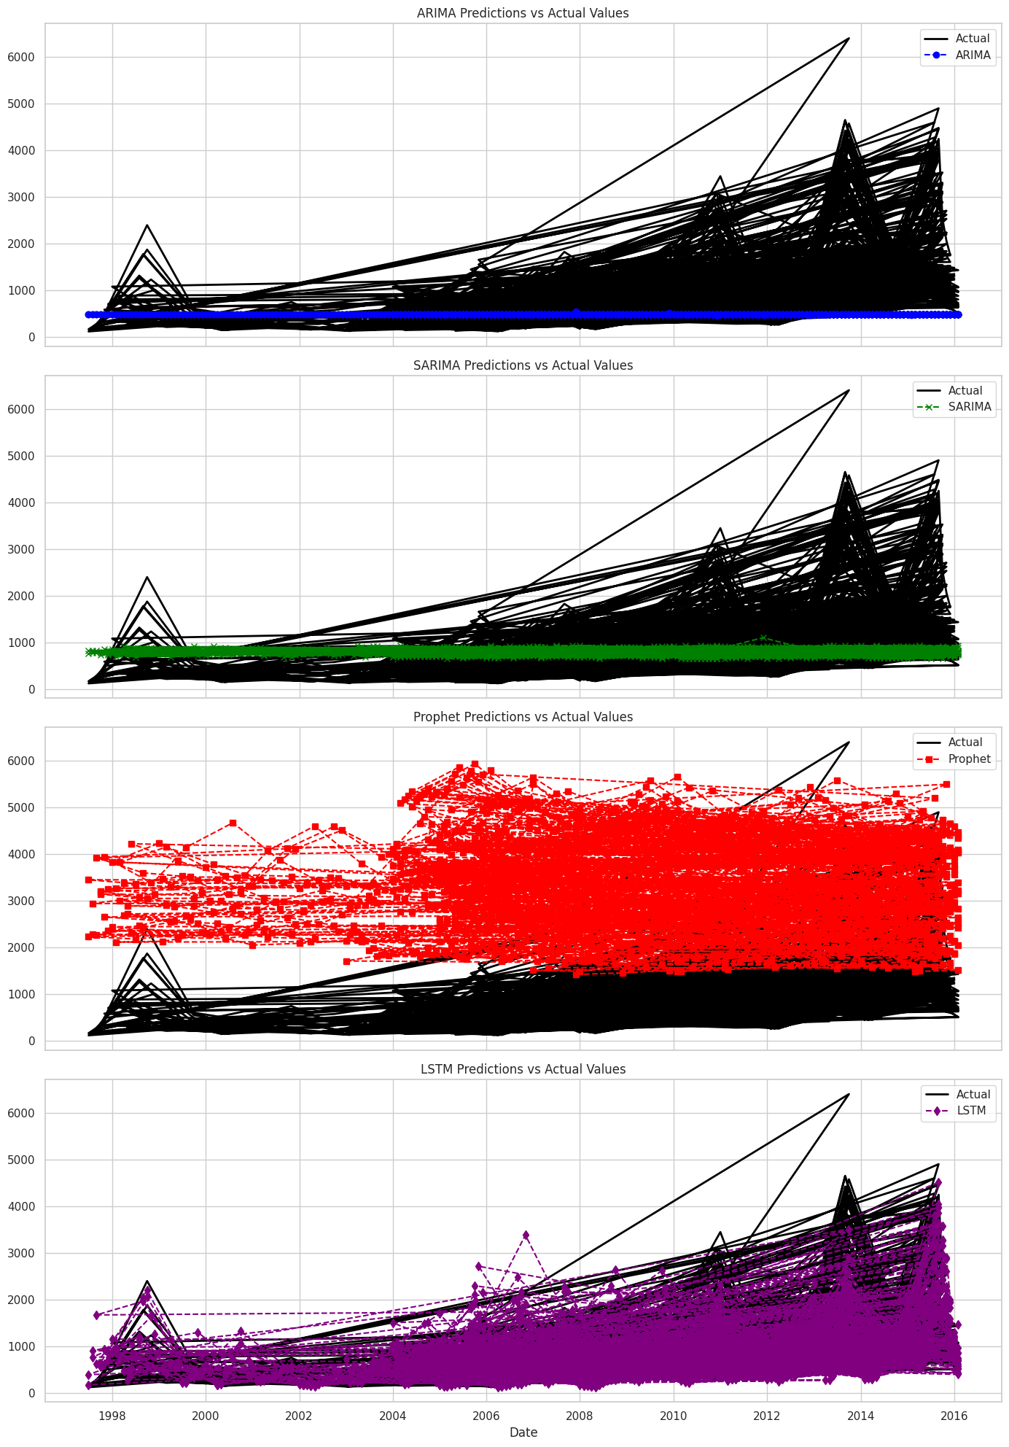

Slide 24
Conclusion
Further improvements can be achieved by exploring more advanced models and feature engineering techniques.

Slide 25
Thank you
Radwan Mohamed Amin Hefny
01203741440
radwanmoh1624@gmail.com

